Slide 1
Grunt JSHint Plugin
Olivier Liechti & Simon Oulevay
COMEM Web Services 2016

Slide 2

How do I code quality JavaScript?

Slide 3
Enter JSHint
JSHint is a community-driven tool to detect errors and potential problems in JavaScript code and to enforce your team's coding conventions. It is very flexible so you can easily adjust it to your particular coding guidelines and the environment you expect your code to execute in.
http://jshint.com/about/

Slide 4

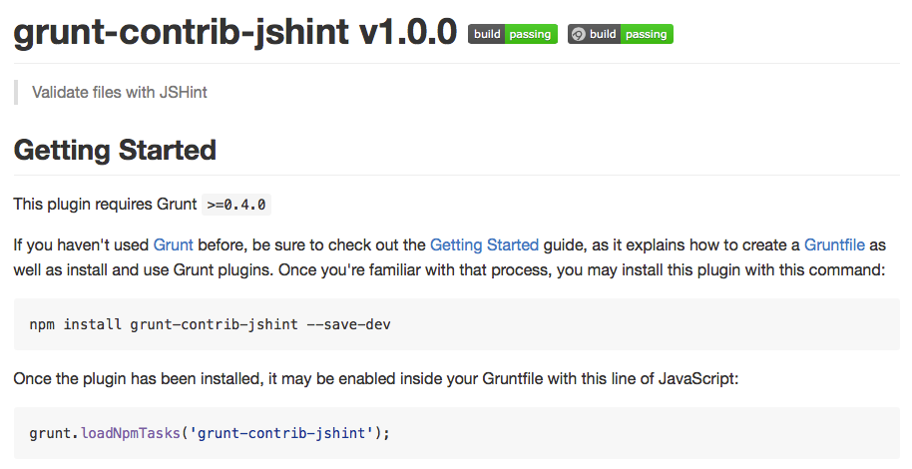
Another tool to install?
Grunt to the rescue

Slide 5
Install grunt-contrib-jshint
Install the plugin:
$> cd /path/to/express/project
$> npm install --save-dev grunt-contrib-jshint
Add a jshint section to your Gruntfile and load the plugin's tasks:
module.exports = function(grunt) {
grunt.initConfig({
// ... previous plugin configs
jshint: {
all: [ "Gruntfile.js", "app/**/*.js", "public/js/**/*.js", "app.js" ]
},
// ... next plugin configs
});
grunt.loadNpmTasks("grunt-contrib-jshint");
}

Slide 6
Install grunt-contrib-jshint
Run the plugin with grunt jshint:
$> grunt jshint
Running "jshint:all" (jshint) task
Gruntfile.js
1 |'use strict';
^ Use the function form of "use strict".
3 |var request = require('request');
^ 'require' is not defined.
7 | require('time-grunt')(grunt);
^ 'require' is not defined.
9 | require('load-grunt-tasks')(grunt);
^ 'require' is not defined.
5 |module.exports = function (grunt) {
^ 'module' is not defined.
70 | setTimeout(function () {
^ 'setTimeout' is not defined.
>> 6 errors in 6 files
Warning: Task "jshint:all" failed. Use --force to continue.
Aborted due to warnings.
What do you mean "require is not defined"? It's Node.js, dude.

Slide 7
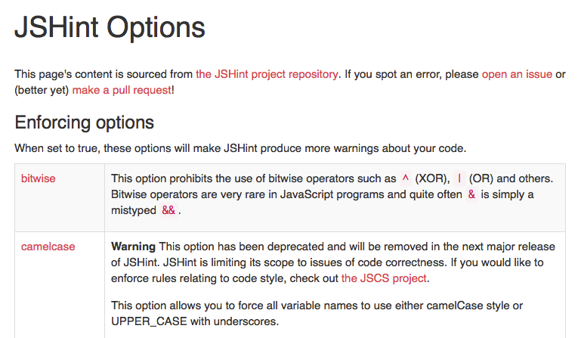
Install grunt-contrib-jshint
http://jshint.com/docs/options/

Slide 8
Configure JSHint
Add the node option to the JSHint plugin's task configuration:
jshint: {
options: {
node: true
},
all: [ "Gruntfile.js", "app/**/*.js", "public/js/**/*.js", "app.js" ]
}
Run it again:
$> grunt jshint
Running "jshint:all" (jshint) task
>> 6 files lint free.
Done, without errors.
Yay!
If you still have errors, either you've written bad code, or there are more options to configure.

Slide 9
Add JSHint to the default ask
Add the JSHint task to your default Grunt task if you want JSHint to run every time you make a change:
grunt.registerTask('default', [
'stylus',
'jshint',
'develop',
'watch'
]);

